Slide 1
DEFINE
MEASURE
ANALYZE
IMPROVE
CONTROL
PROBLEM STATEMENT
BIG Y: BALL GUIDE CONSUMPTION NOT MANAGED AS PER PLANNING
MASTER BLACK BELT : MR. ALOK SHARMA
CHAMPION : MR. LATESH GOYAL (PLANT HEAD)
GREEN BELT : ANKIT SAKLANI, GAURAV SHARMA, ANKIT (Project Leader)
COMPANY : TOYOTA BOSHOKU DEVICE INDIA PVT LTD.
BUSINESS : SEAT SLIDER, SEAT RECLINER
SUPPORT TEAM MEMBERS :
TECH Y (NARROWED PROBLEM STATEMENT):
BALL GUIDE CHANGE AFTER UPPER & LOWER RAIL CHANGE IN ASSY. LINE
CTP: AT DURING BALL GUIDE INSERT IN SEAT TRACK MACHINE
CRITICAL TO (QUALITY,COST,DELIVERY, SATISFACTION OF CUSTOMER) :-
CRITICAL TO QUALITY / CRITICAL TO COST
TARGET:-
BALL GUIDE DOES NOT CHANGE EVEN UPPER & LOWER RAIL CHANGE
SIGMA LEVEL INCREASE – Min. 1 SIGMA
CURRENT SIGMA-
ACTION START : 09/12/2024
MEASURE: >> 18/12/24 TO 17/01/25
ANALYSE: >> 18/01/25 TO 23/02/25
IMPROVE: >> 24/02/25 TO
CONTROL: >>
PROJECT TENTATIVE END DATE :
COPQ CALCULATION;
PRODUCTION /DAY : 25000 nos.
BALL GUIDE USE/ DAY : 100000 nos.
COST OF 1 BALL GUIDE : ₹ 2.73
NO OF DAYS OF EXCESS INVENTORY : 15 DAYS
COST TO COMPANY : ₹ 40.95 Lakh

Slide 2
MONTH WISE BALLGUIDE CONSUMPTION
DEFINE

Slide 3
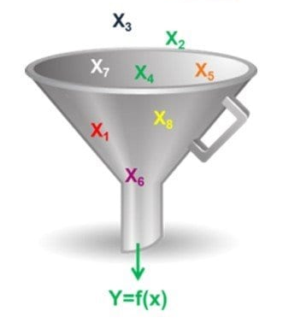
What :- BALL GUIDE CONSUMPTION IS NOT MANAGE AS PER THE PLANNING Who:- SCM PERSON When:- DURING RAIL CHANGE Where :- SEMI AUTO MACHINE AT SEAT SLIDER ASSY. LINE Why:- SLIDING FORCE OUT OF SPEC. (14.7 - 50.0 KN) How :- VARIATION IN ROLLING FRICTION BETWEEN BALL & RAILS How Much:- BALL CONSUMPTION FLUCTUATION 9% TO 21%
DEFINE
BIG-Y
TECH-Y
FORCE VARIATION

Slide 4
WE CONDUCT 30 PART OF YY8 TOOL FOR CHECK FORCE VARIATION IN SAME BALL GUIDE(BALL SIZE-5.5mm)
MEASURE

Slide 5
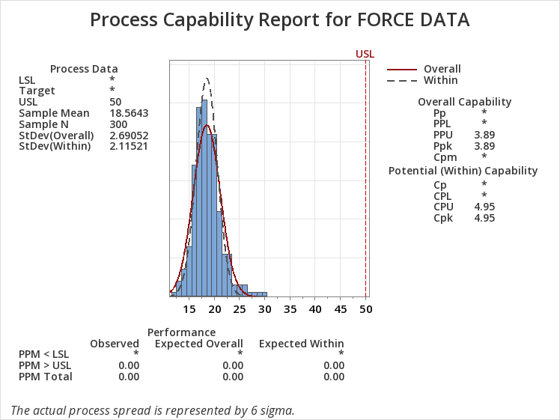
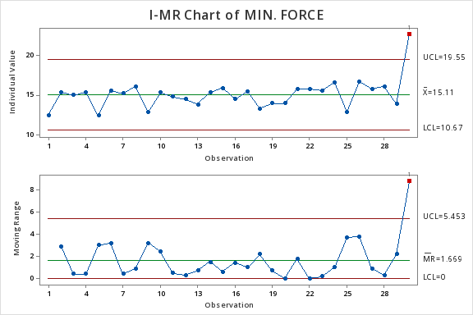
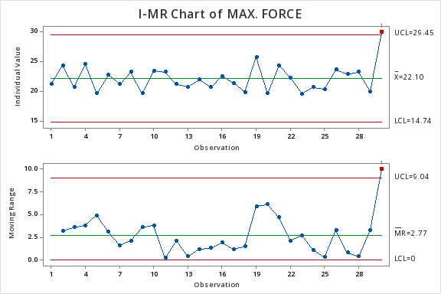
MEASURE
YY8 RAIL FORCE DATA AT 5.5 MM BALL GUIDE
Cpk value is 4.95

Slide 6
WE CONDUCT 30 PART OF YFG TOOL FOR CHECK FORCE VARIATION IN SAME BALL GUIDE(BALL SIZE-5.5mm)
MEASURE

Slide 7
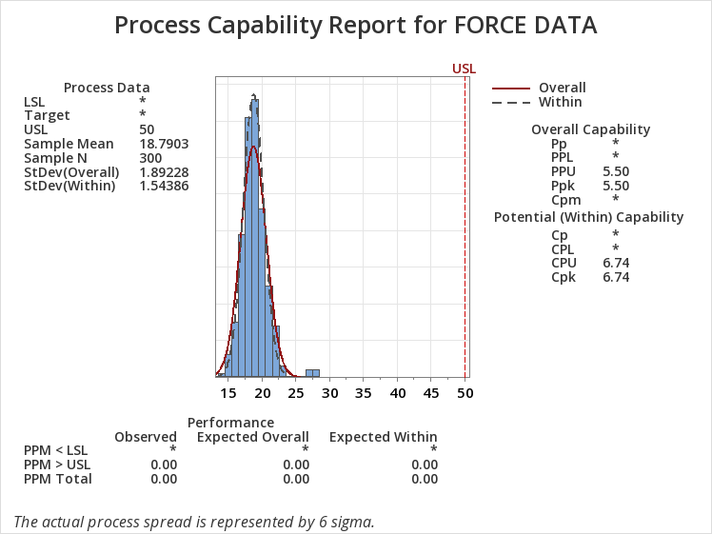
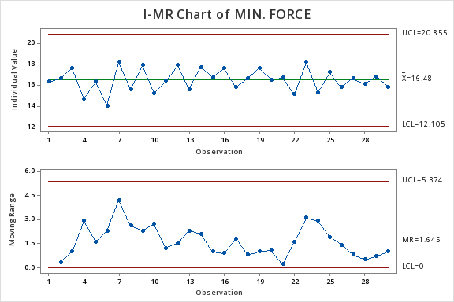
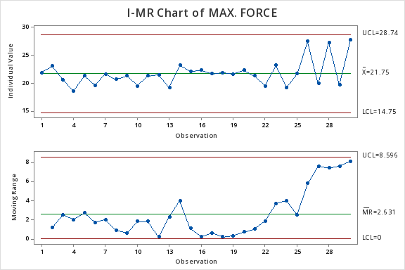
MEASURE
YFG RAIL FORCE DATA AT 5.5 MM BALL GUIDE
Cpk value is 6.74

Slide 8
WE CONDUCT 30 PART OF YTA TOOL FOR CHECK FORCE VARIATION IN SAME BALL GUIDE(BALL SIZE-5.5mm)
MEASURE

Slide 9
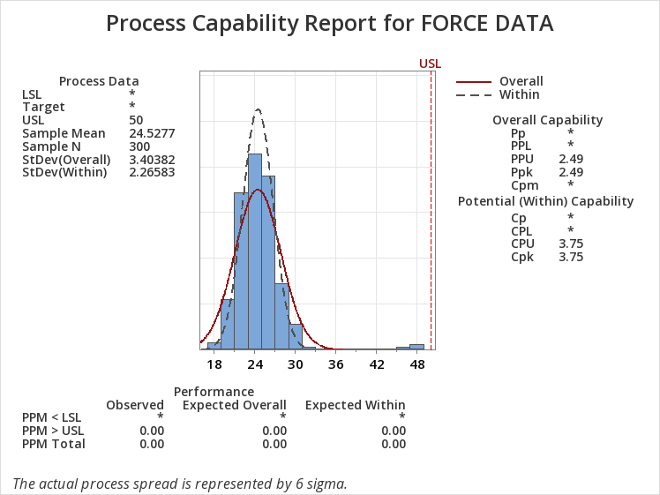
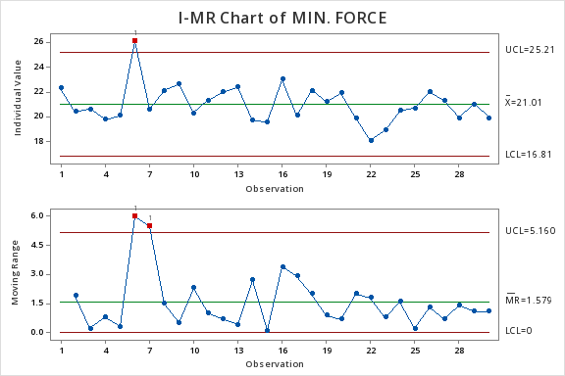
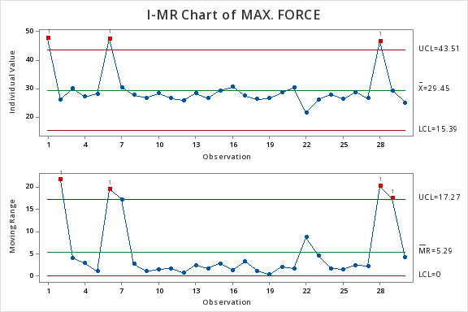
MEASURE
YTA RAIL FORCE DATA AT 5.5 MM BALL GUIDE
Cpk value is 3.75

Slide 10
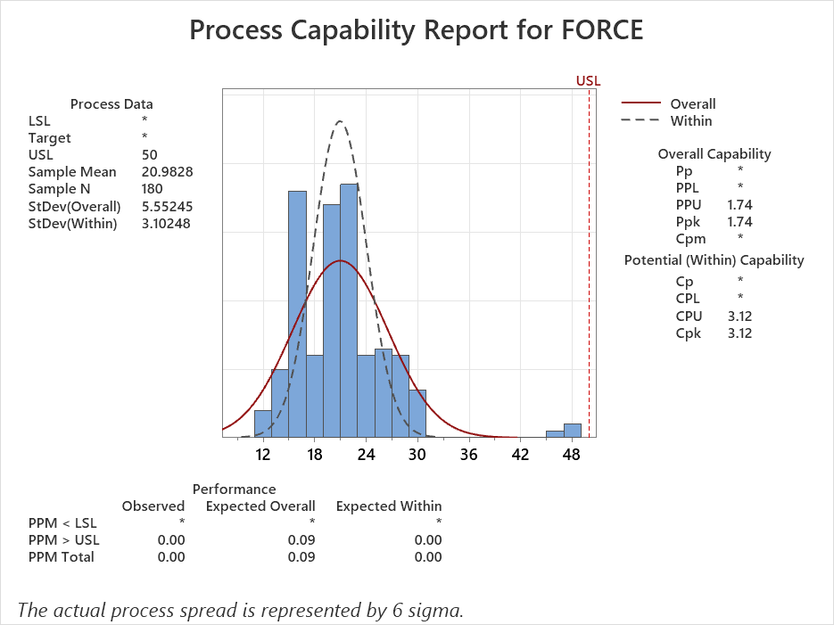
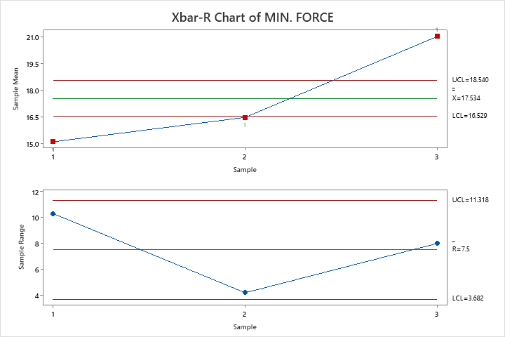
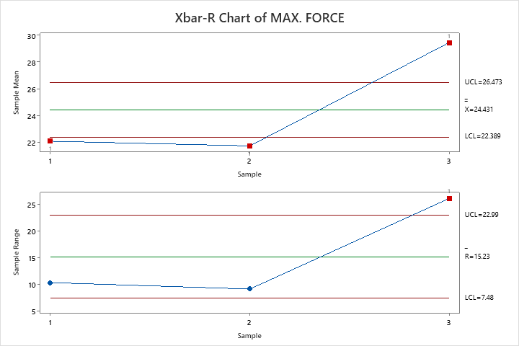
MEASURE
COMBINED FORCE DATA OF ALL RAIL IN 5.5 MM BALL GUIDE
Cpk value is 3.12

Slide 11
WE CONDUCT 30 PART OF YY8 TOOL FOR CHECK FORCE VARIATION IN SAME BALL GUIDE(BALL SIZE-5.6mm)
MEASURE

Slide 12
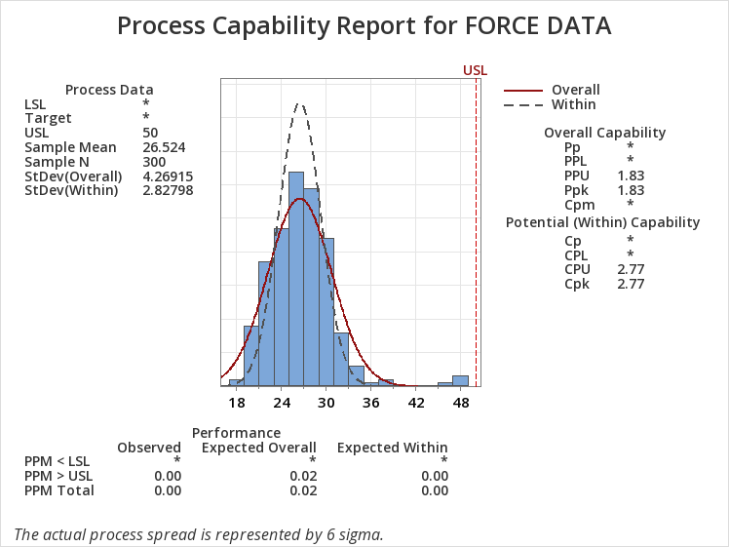
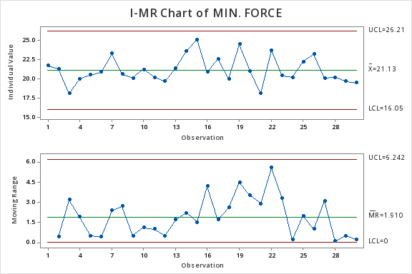
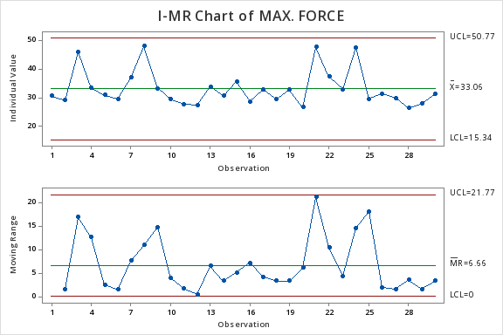
MEASURE
YY8 RAIL FORCE DATA AT 5.6 MM BALL GUIDE
Cpk value is 2.77

Slide 13
WE CONDUCT 30 PART OF YFG TOOL FOR CHECK FORCE VARIATION IN SAME BALL GUIDE(BALL SIZE-5.6mm)
MEASURE

Slide 14
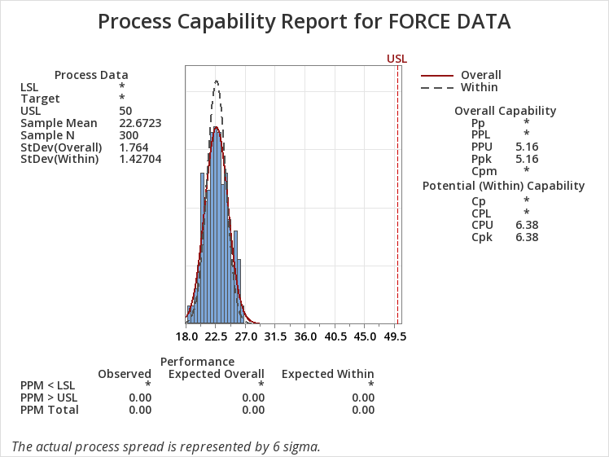
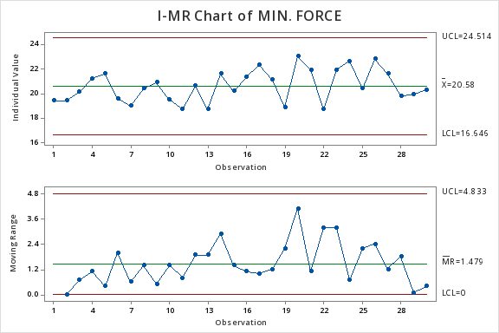
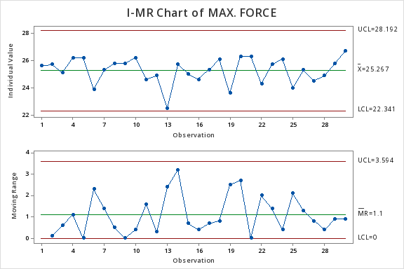
MEASURE
YFG RAIL FORCE DATA AT 5.6 MM BALL GUIDE
Cpk value is 6.38

Slide 15
WE CONDUCT 30 PART OF YTA TOOL FOR CHECK FORCE VARIATION IN SAME BALL GUIDE(BALL SIZE-5.6mm)
MEASURE

Slide 16
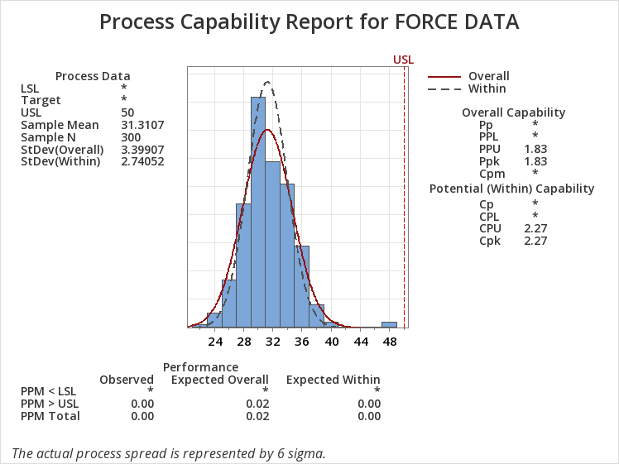
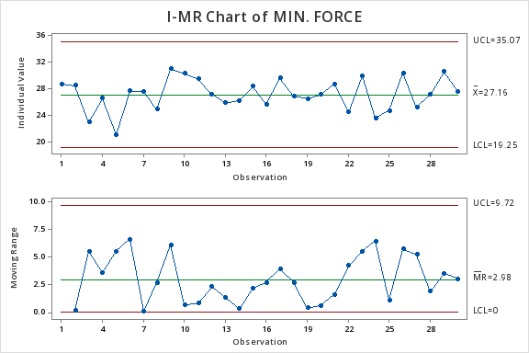
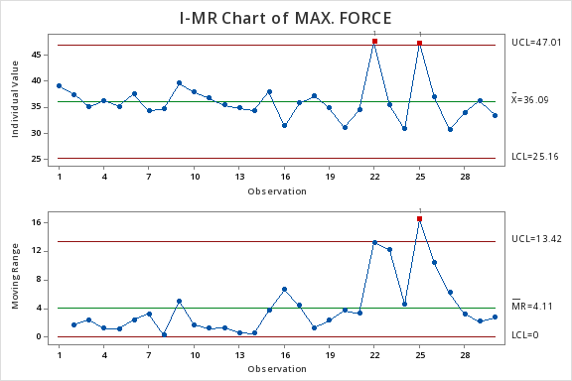
MEASURE
YTA RAIL FORCE DATA AT 5.6 MM BALL GUIDE
Cpk value is 2.27

Slide 17
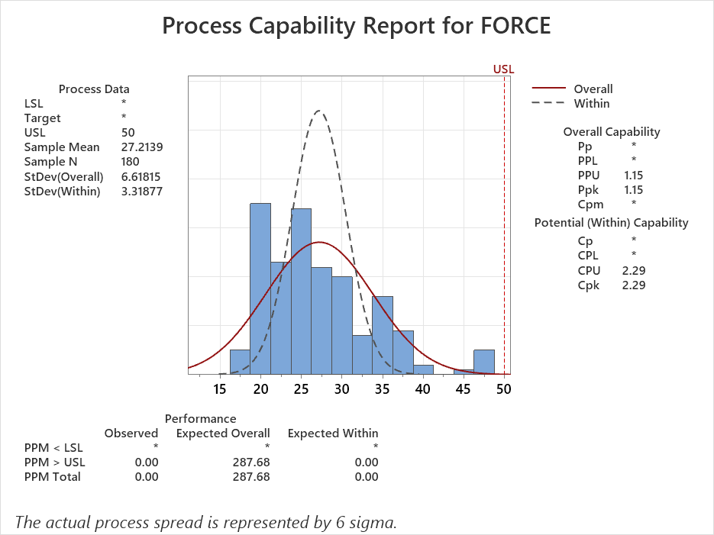
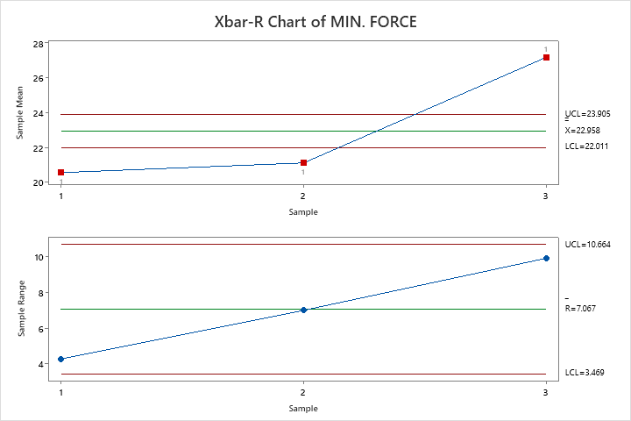
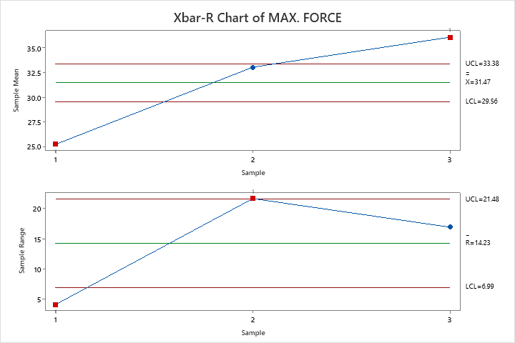
MEASURE
COMBINED FORCE DATA OF ALL RAIL IN 5.6 MM BALL GUIDE
Cpk value is 2.29

Slide 18
ANALYSIS
PROCESS MAPPING
Key Process Input Variables (KPIV)
INCOMING
PROCESS PARAMETERS
BOP & Child Parts
1 Guide
2 Lower Rail
3 Upper Rail
Previous Process Output
1. After welding upper rail deformation
2. After Tab bending lower rail deformation
Machine
1. Rod cylinder Air pressure more
2 . Rod alignment not ok.
3. Rod surface wear-out
4. Guide holding clamp air pressure more/less.
Tools/Jig/Fixture
1. Ball guide holding clamp loose.
2. Ball guide holding clamp magnet weak.
3. Upper rail holding block wear-out
4. Greasing not proper on jig sliding area
Human Variation
Area sensor fault during guide interstation
Guide Assy not properly placing on the clamp
Environment
N/A
PROCESS
Key Process Output Variables (KPOV)
Min. & Max. sliding force

Slide 19
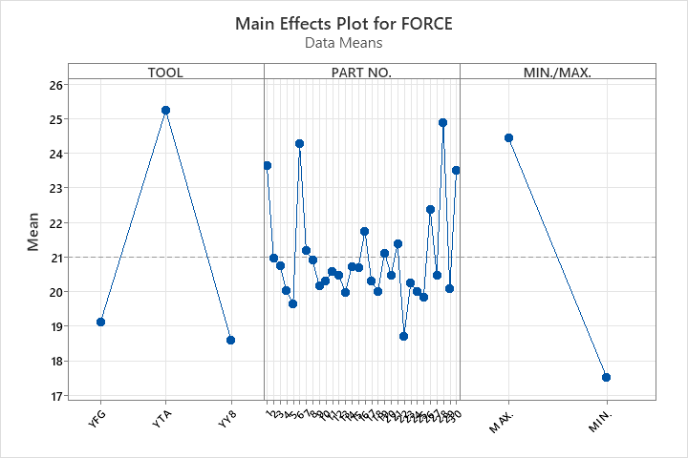
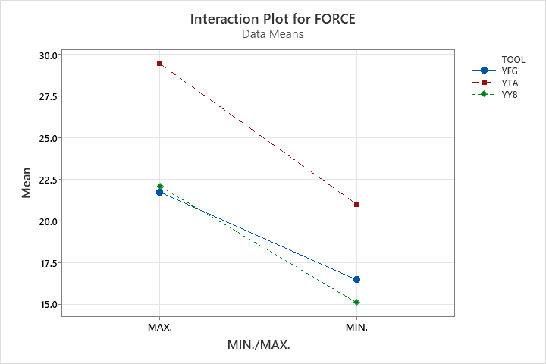
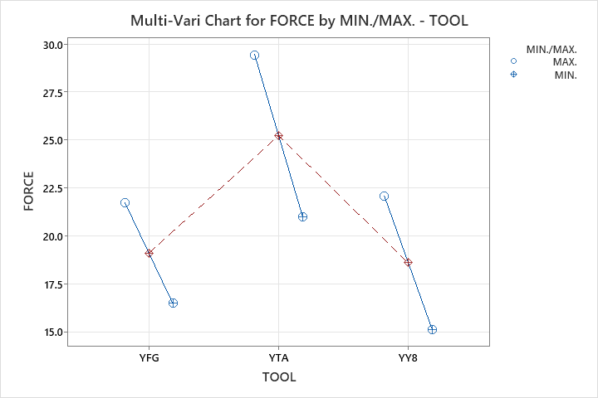
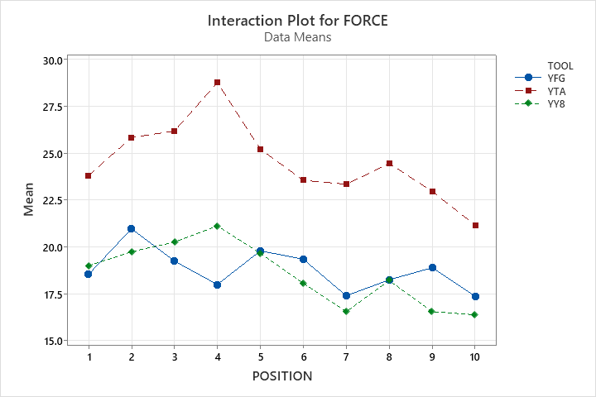
ANALYSIS
FORCE COMPRESSION OF ALL RAIL in 5.5 mm BALL GUIDE

Slide 20
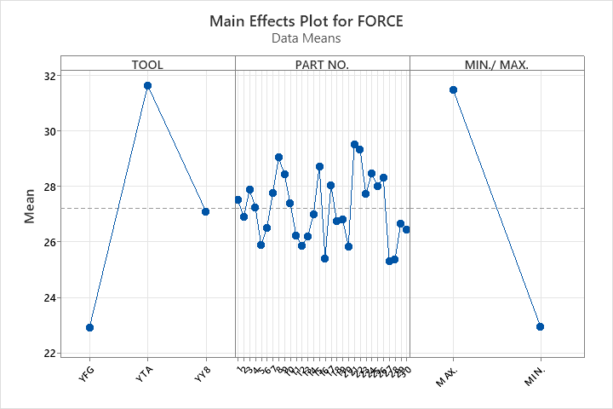
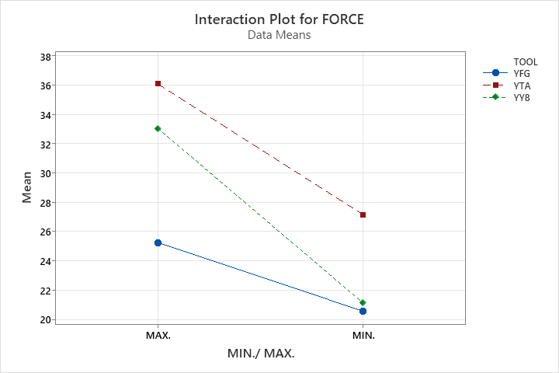
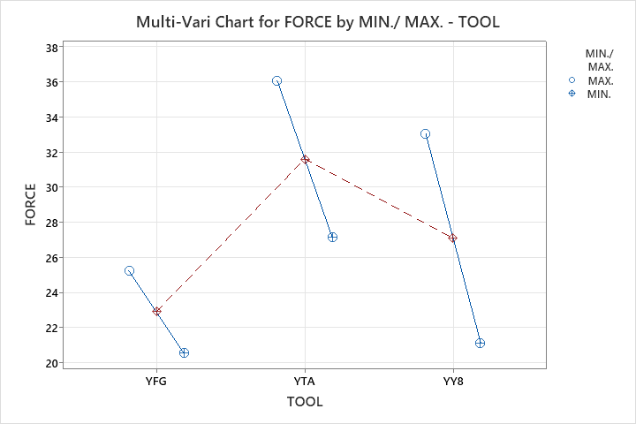
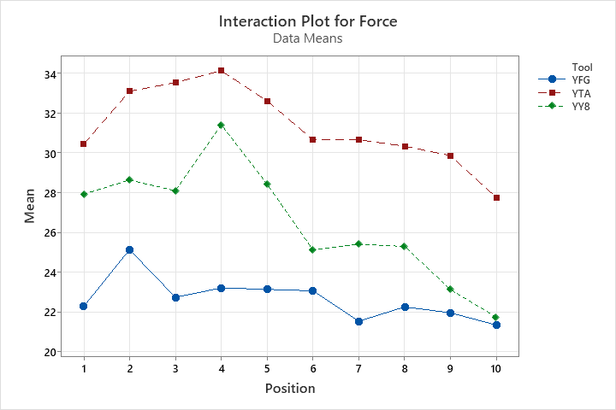
ANALYSIS
FORCE COMPRESSION OF ALL RAIL in 5.6 mm BALL GUIDE

